Slide 1
Predicting Daily Closing Price Variation for Apple Stock
By: Jhony Ortiz, Aaron Hayward, and Sai Moturi

Slide 2

Main Objective
Our main objective for this project was to analyze the trend in stock prices for Apple Inc. from 100 days prior to May 5th, 2021; this was done to predict if the closing prices were higher or lower than the opening prices for this time frame.
This would tell us whether the stock was trending upward or downward both daily and overall from when data was collected.

Slide 3

Dataset Utilized
While we utilized the dataset to collect from December 10th of 2020 to May 5th of 2021, the entirety of the dataset actually contained data for the past 20 years.
This dataset was obtained directly from Yahoo finance due to its access to stock prices across different periods of time.

Slide 4
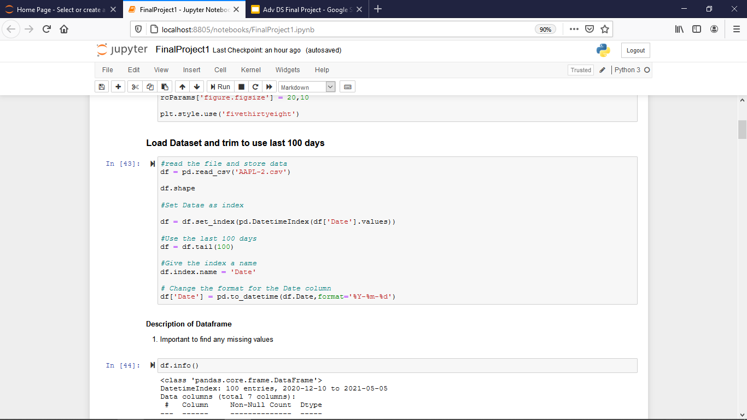
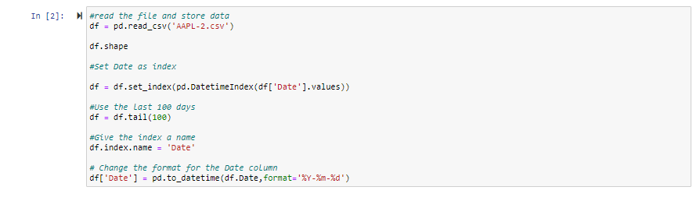
Data Cleaning

Slide 5
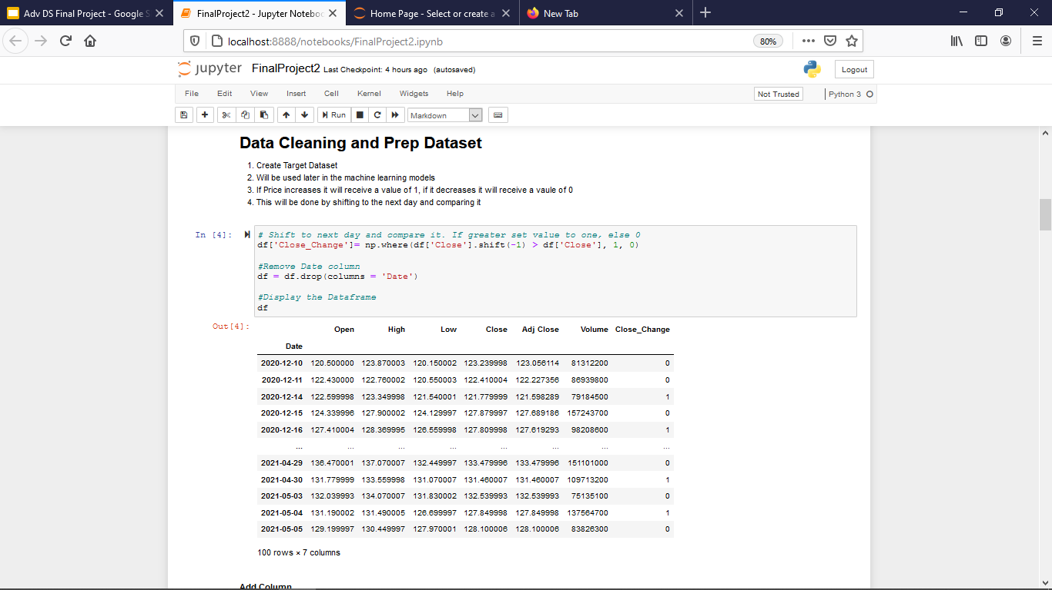
Data Cleaning

Slide 6
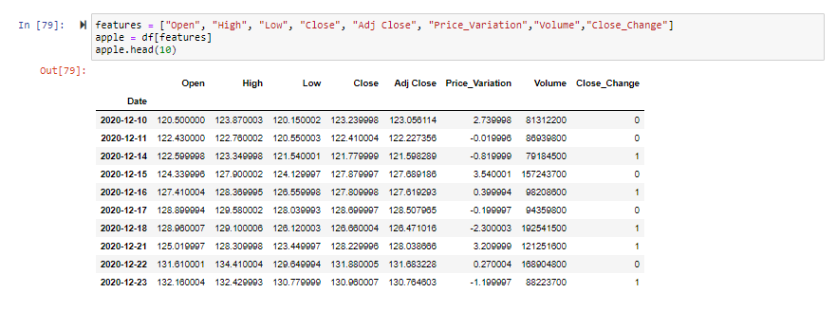
Post Data Cleaning & Data Preparation

Slide 7
Data Analysis Technique: Classification
Data Classification was utilized within this project specifically to analyze the stock prices on a daily basis in determination of whether or not specific days experienced an overall rise of fall from their opening to closing prices.

Slide 8
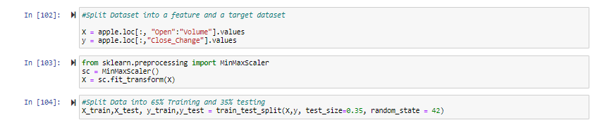
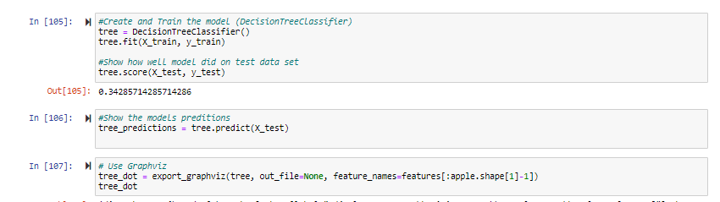
Decision Tree

Slide 9
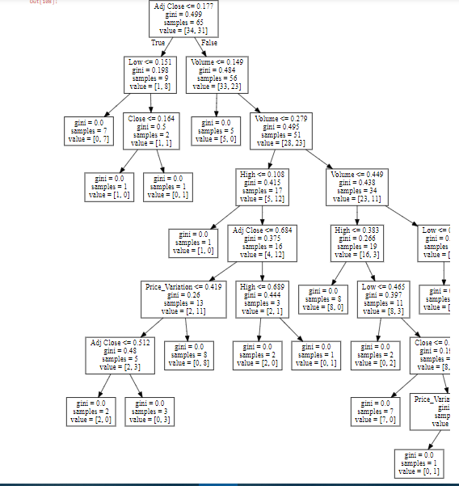
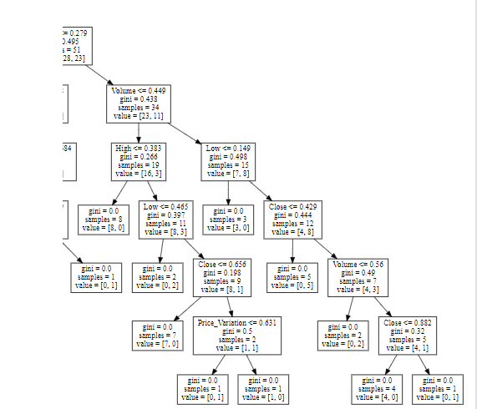
Decision Tree

Slide 10
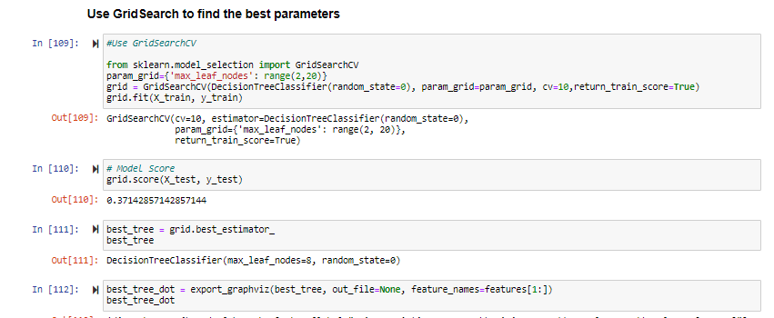
Hyper Tuning Parameters

Slide 11
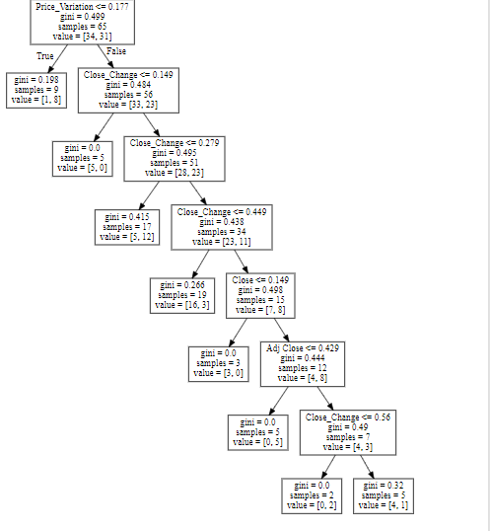
Decision Tree

Slide 12
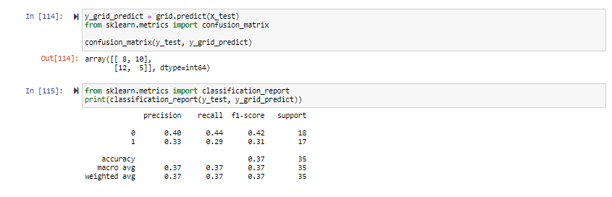
Decision Tree Metric

Slide 13
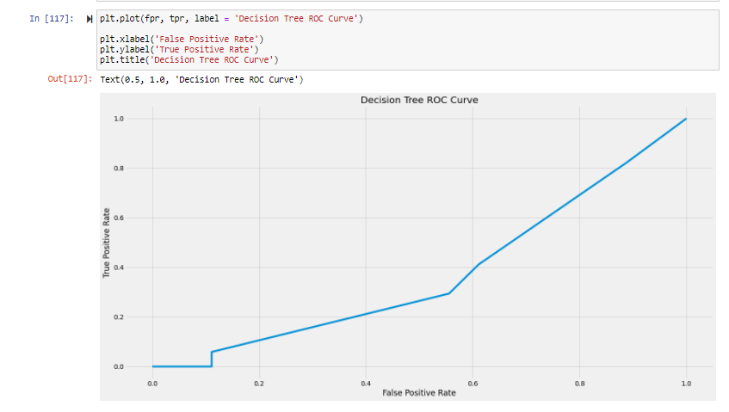
Decision Tree

Slide 14
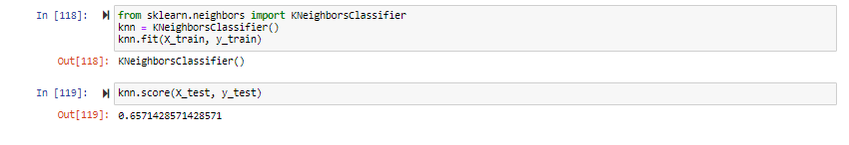
KNN: K Nearest Neighbor

Slide 15
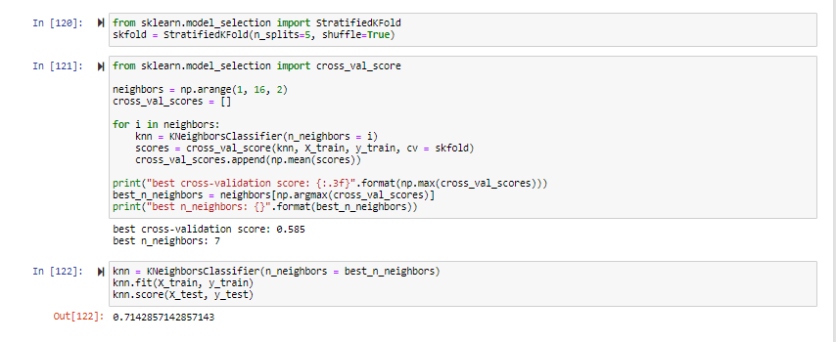
Hyper Tuning Parameters

Slide 16
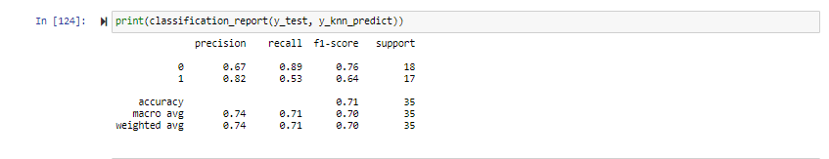
KNN: K Nearest Neighbor

Slide 17
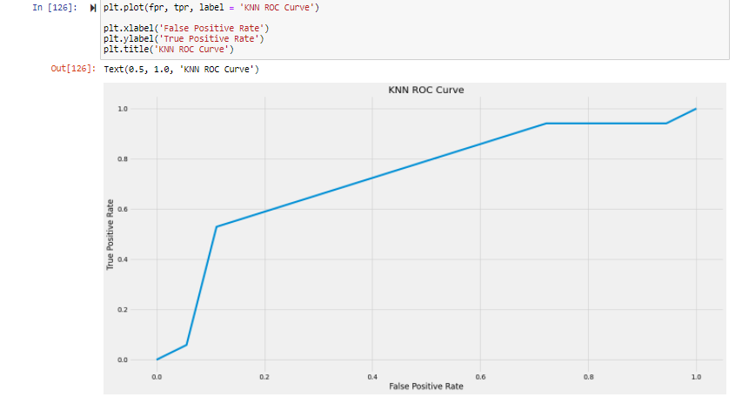
KNN: K Nearest Neighbor

Slide 18
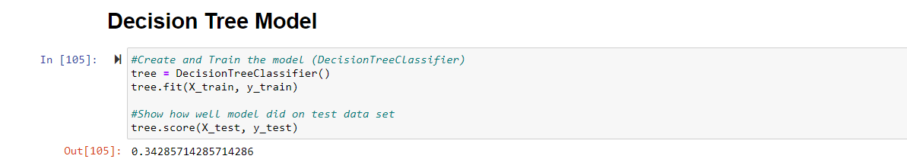
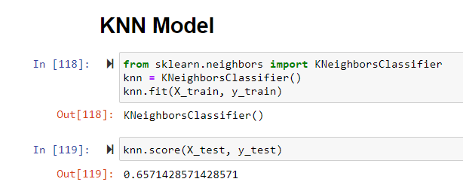
Evaluation/
Comparison of M.L. Models Utilized
To conclude, our overall accuracy did not achieve the level of height we had initially sought to strive for.
The KNN ultimately performed better than the Decision Tree model.
More specifically, the Decision Tree scored an accuracy of 34.29% while the KNN scored an accuracy of 65.71%. Post hypertuning there was a slight increase for both, with the Decision Tree becoming 37.14% and the KNN becoming 71.43%. The Decision Tree utilized Gridsearch whilst the KNN utilized the cross valuation.

Slide 19
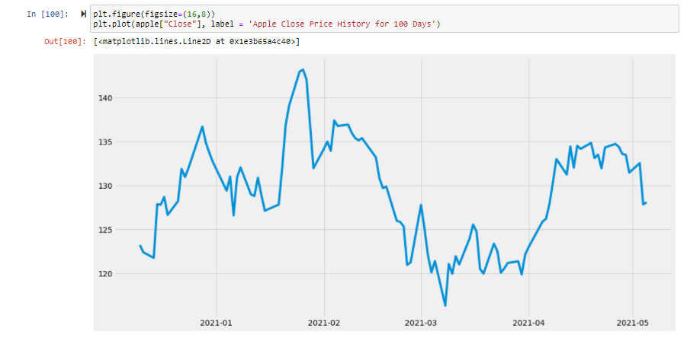
Data Visualization of Results: Line Chart

Slide 20
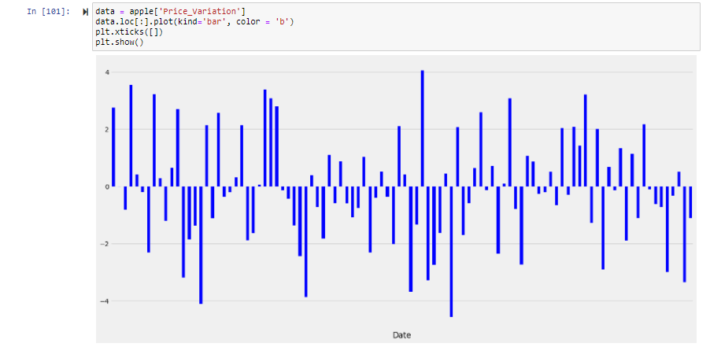
Data Visualization of Results: Bar Graph

Slide 21
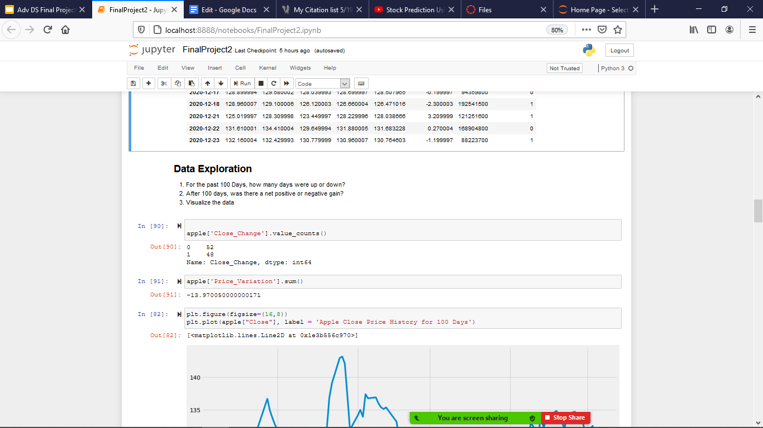
Final Conclusions Drawn From Project
The results of this project have shown that from the dataset analyzed, 52 days in total experienced a net decrease from opening to closing stock prices. Conversely, 48 days experienced a net increase from the opening to closing stock value.
In total, after the studied 100 day period there was a net negative decrease from opening to closing prices by approximately $13.97.

Slide 22

Works Cited
Cheng, A. (2020, February 11). Machine Learning: Step-By-Step. Medium. https://towardsdatascience.com/machine-learning-step-by-step-6fbde95c455a.
Yahoo! (2021, May 17). Apple Inc. (AAPL) Stock Historical Prices & Data. Yahoo! Finance. https://finance.yahoo.com/quote/AAPL/history/.
YouTube. (2020). Stock Prediction Using Python & Machine Learning. YouTube. https://www.youtube.com/watch?v=tQx-XGPecBA.

